Slide 1

TRAINING AND DEVELOPMENT
STATISTICS
&
MACHINE LEARNING INTRO

Slide 2
Content
INTRO TO STATISTICS
What is Statistics?
Big Picture of Statistics
The Process of Statistics
INTRO TO ML
Difference between conventional programming and Machine Learning
Inference vs Prediction
The Process of Machine Learning
Demo : Medical Data EDA App

Slide 3
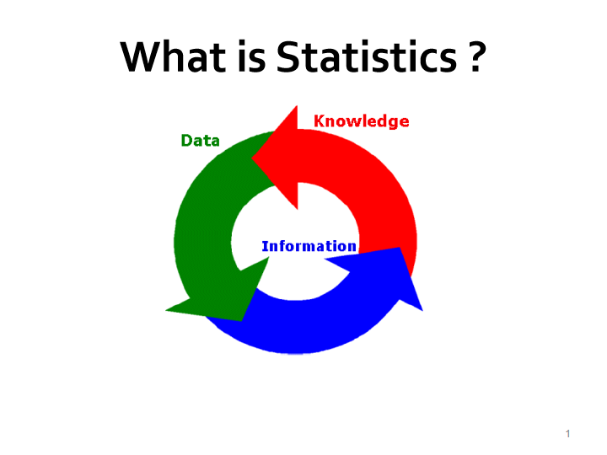

Slide 4
What is Statistics ?
Statistics is the science of :
Collection
Organization
Summarization
Interpretation , and
Making Decisions/Drawing Conclusions
From Data

Slide 5
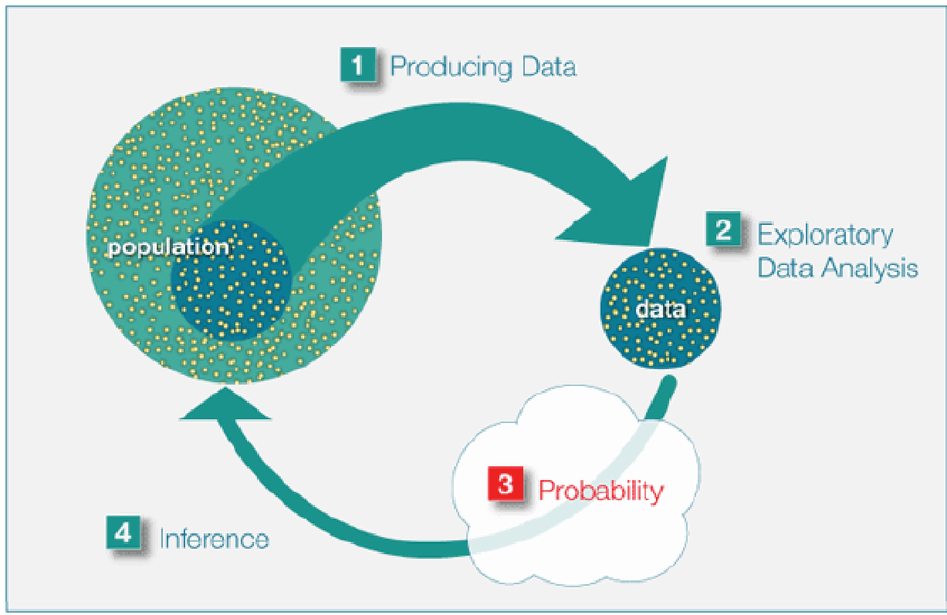
Big Picture of Statistics

Slide 6
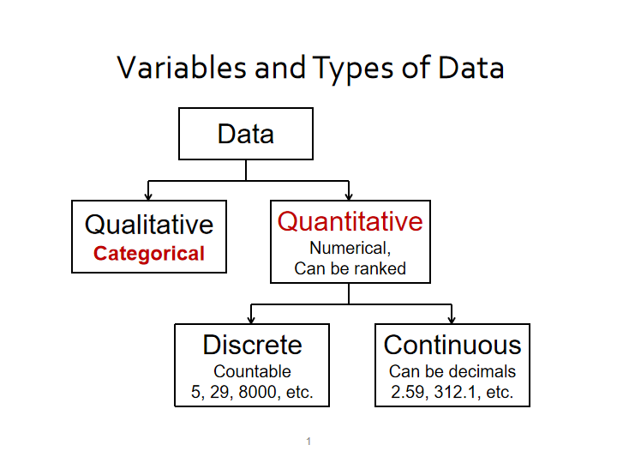

Slide 7
Pop Quiz : Variables & Data
The height of president Lincoln is a variable ( True or False)?
False, height is a variable but height of president Lincoln is a
data point (datum).

Slide 8
Pop Quiz : Choose data type for each variable
Height in cms
Employment status
Income status - low , middle , high
Count of jeans sold in a store
Race car lap time
Number of trees in a field
Customer satisfaction- unsatisfied, neutral , satisfied

Slide 9
Two Branches of Statistics
Descriptive statistics: Consists of Organizing , Summarizing and Visualizing data to get interesting patterns and insights
Inferential statistics: Generalizing from samples to populations in the form of estimations, hypothesis testing and correlation studies

Slide 10
Identify whether descriptive or inferential statistics is used
Given SAT score for 50 randomly selected students in a school what is the average SAT score for all students of the school
Given data on all purchases what is the average amount spent per customer
Given data on all projects completed what percentage were delivered in time
Given the sleep hours per night in 100 randomly selected adults, what percentage all adults sleep at least 6 hours per day

Slide 11
What does EDA entail?
Organize
Describe
Visualize Data to get interesting patterns and insights

Slide 12
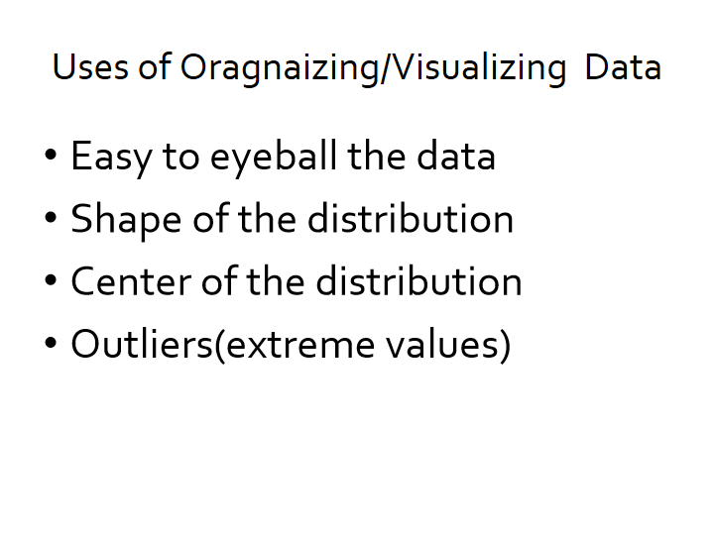

Slide 13
Raw Data
CATEGORICAL DATA
Twenty-five army students were given a blood test to determine their blood type.
Raw Data: A,B,B,AB,O , O,O,B,AB,B , B,B,O,A,O , A,O,O,O,AB , AB,A,O,B,A
NUMERICAL DATA
The following data represent the record high temperatures for each of the 50 states.
112 100 127 120 134 118 105 110 109 112 110 118 117 116 118 122 114 114 105 109
107 112 114 115 118 117 118 122 106 110 116 108 110 121 113 120 119 111 104 111
120 113 120 117 105 110 118 112 114 114

Slide 14
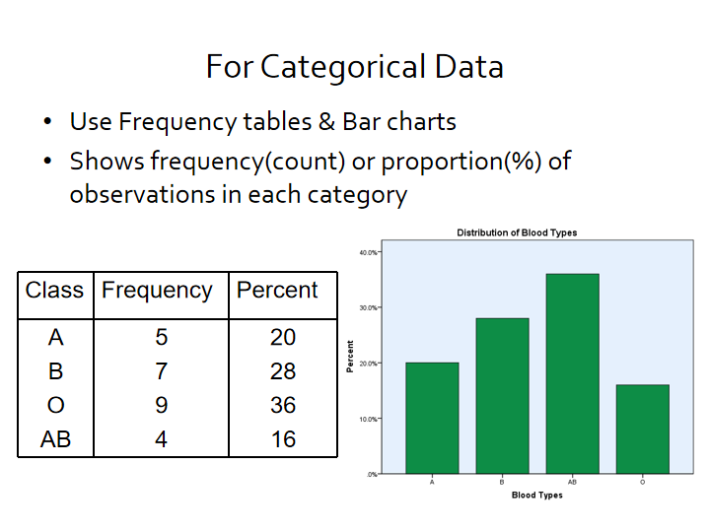

Slide 15
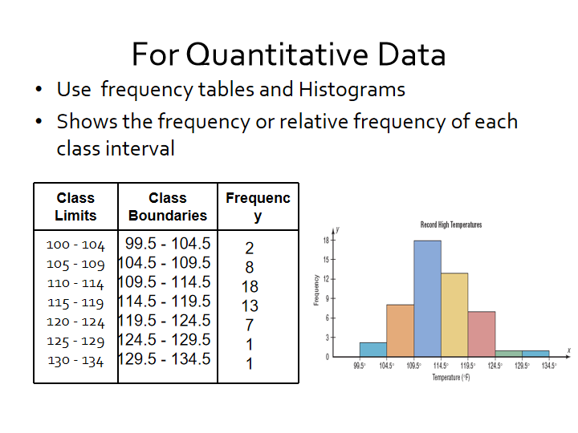

Slide 16
Summarizing Data–Measures of Center
Average –
Mean
Median
Mode
Do you want to get average marks ?

Slide 17
Calculating Mean ,Median and Mode
Find the mean, median and mode of the signing bonuses of eight IPL players for a specific year. The bonuses in millions of rupees are
18.0, 14.0, 34.5, 10, 11.3, 10, 12.4, 10
Mean = sum of observations /number of observations =
= (18.0 + 14.0 + 34.5 + 10 + 11.3 +10 +12.4 +10) / 8
= 120.2 /8 = 15.025 = 15.03 million rupees (rounded to one decimal place more than raw data)
Median is the centermost observation after sorting the data
Sorted Data : 10, 10, 10, 11.3, 12.4, 14.0, 18.0, 34.5
Median = mean of 4th and 5th observation
= (11.3 + 12.4)/2
= 11.85 million rupees
Mode is the most frequently occuring observation
The mode is 10 million rupees

Slide 18
Which diet is better?
Latest Weight loss diet
DIET -1
Mean Weight loss = 34.5 Kg
Latest Weight loss diet
DIET -2
Mean Weight loss = 18.5 Kg

Slide 19
Which diet is better : Analyze and Decide
The change in weight (lbs) of two dieting groups is shown :
Diet 1: +4, +3, 0,-3, -4, -5, -11, -14, -15, -300
Diet2: -8, -10, -12, -16, -18,-20,-21,-24,-26, -30
Calculate the average weight loss in each group and decide which is better.
Answer: Diet 1: mean=-34.5, median =-4.5
Diet 2: mean = - 18.5, median =-19
Diet 2 is better since there are no outliers and mean and
median agree with each other

Slide 20
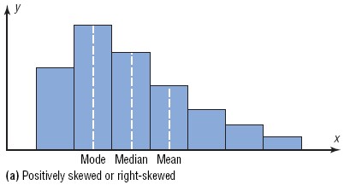
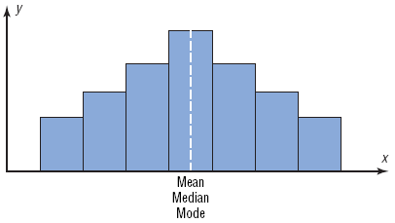
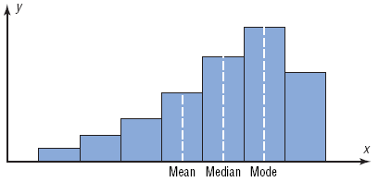
Shapes of Distributions
Note how the mean gets dragged towards the skew
Positively Skewed or Right Skewed
Negatively skewed or eft Skewed
Symmetric

Slide 21
Measures of Variance
Measures of Variance- Spread
Range
Variance
standard deviation
Should I Order only Shirt Size 40 shirts for my Shop as the
average customer size is 40?

Slide 22
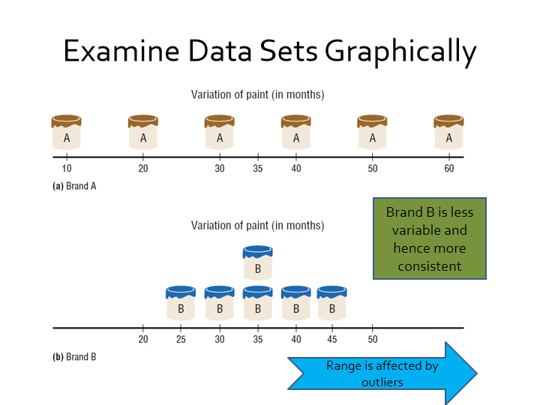

Slide 23
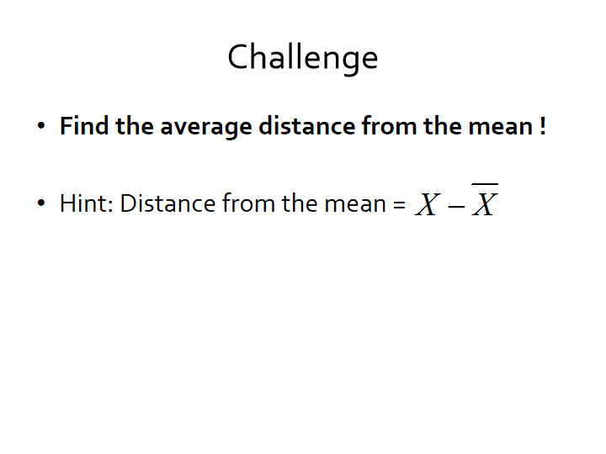

Slide 24
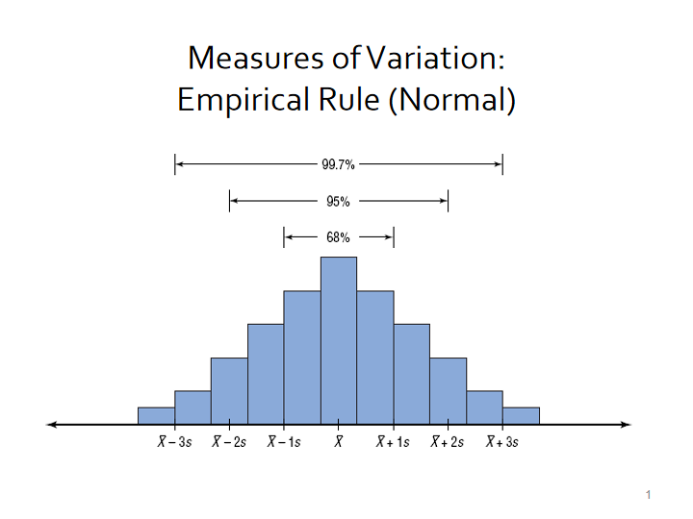
Normal healthy adults have a mean systolic BP of 120 mm of Hg with standard deviation of 10 . What percentage would you expect to have BP :
a) between 100 and 140
b) above 140 mm Hg ?

Slide 25
Range Rule of Thumb
The Range Rule of Thumb approximates the standard deviation as
when the distribution is unimodal and approximately symmetric.

Slide 26
Exploratory Data Analysis(EDA)
The Five-Number Summary is composed of the following numbers: Low, Q₁, MD, Q₃, High
The Five-Number Summary can be graphically represented using a Boxplot.
Boxplot is very useful to catch outliers in the data ( extremely high or low values)

Slide 27
Example Boxplot
Find the 5 number summary and construct a boxplot for the data. 89, 47, 164, 296, 30, 215, 138, 78, 48, 39
Sort the data
30, 39, 47, 48, 78, 89, 138, 164, 215, 296
Five-Number Summary: 30-47-83.5-164-296
Low
Q₁
MD
Q₃
High
47
83.5
164
30
296

Slide 28
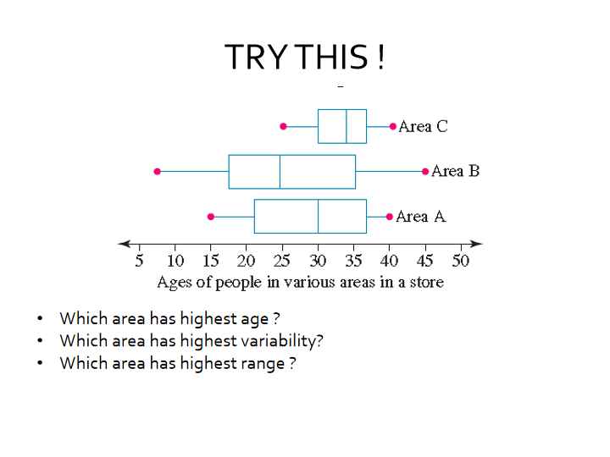

Slide 29
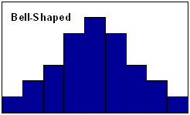
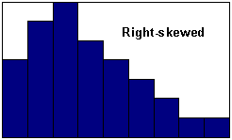
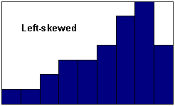
Other EDA Tips- Shapes of Distributions

Slide 30
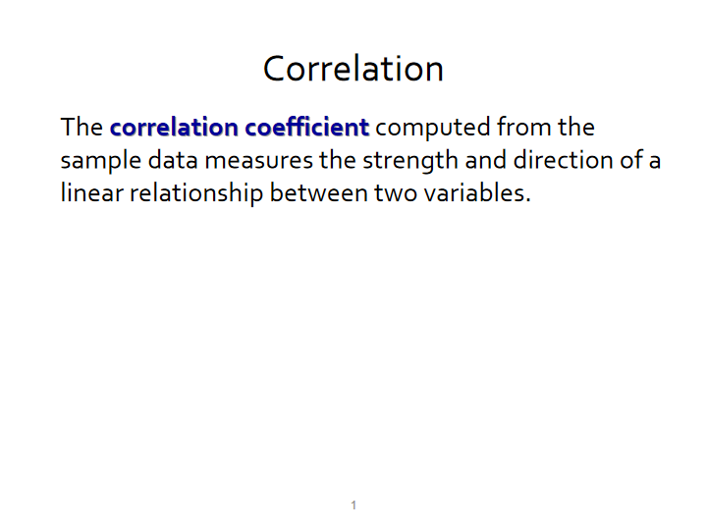
ICE CREAM SALES ARE CAUSING DROWNING DEATHS !!!

Slide 31
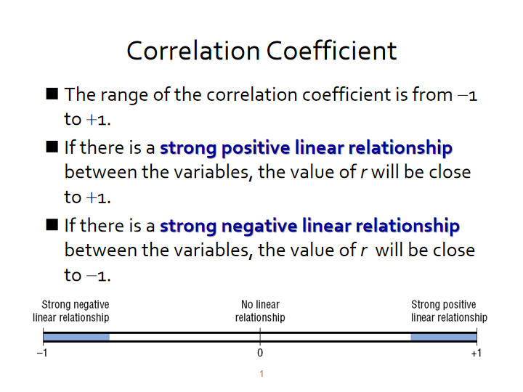

Slide 32
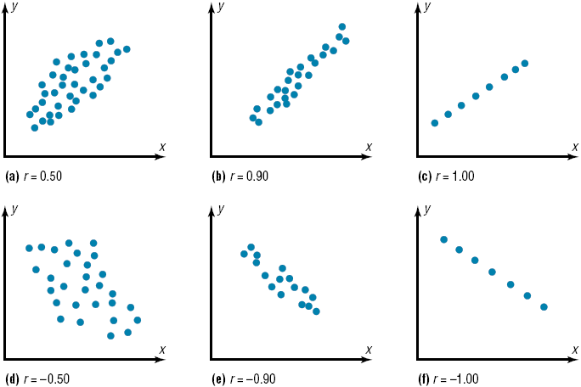
Correlation using Scatter Graphs
Moderate +ve Correlation
Strong +ve correlation
Perfect +ve correlation
Moderate –ve correlation
Strong –ve correlation
Perfect –ve correlation

Slide 33
Correlation is Not Causation
When there is a correlation between two variables any of the following five possibilities can exist.
There is a direct cause-and-effect relationship between the variables. That is, x causes y.
There is a reverse cause-and-effect relationship between the variables. That is, y causes x.
The relationship between the variables may be caused by a third variable.
There may be a complexity of interrelationships among many variables.
The relationship may be coincidental.

Slide 34
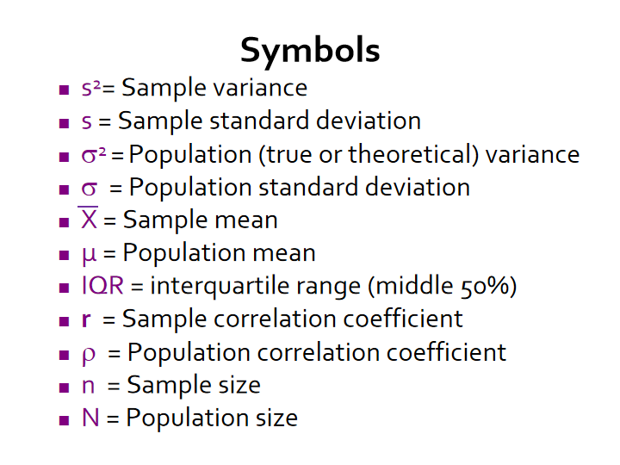

Slide 35
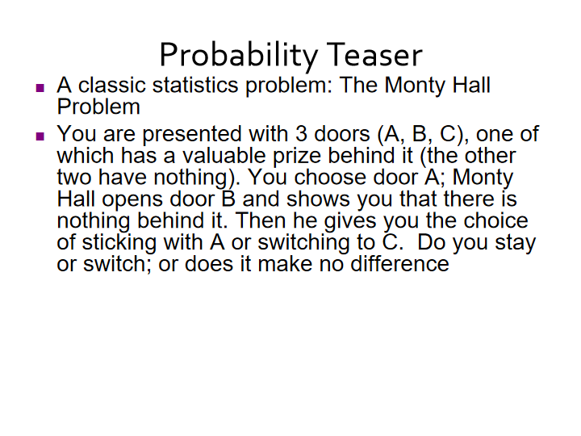

Slide 36
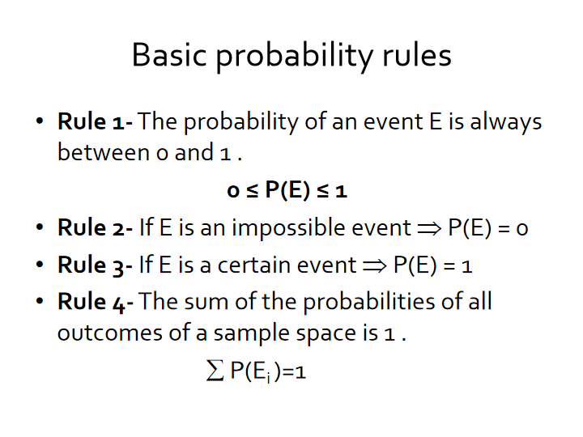

Slide 37
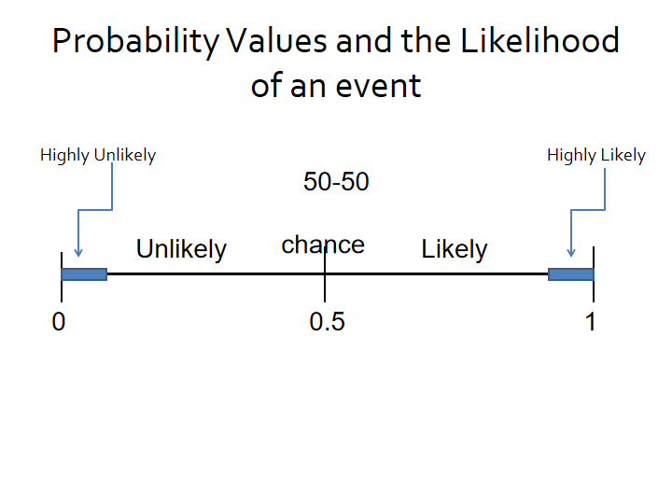

Slide 38
Pop Quiz: Which of the following events is most likely to occur ?
Scoring 90% or more in an exam, when only 5% of students score this highly.
A restaurant receiving an order for a steak, where steak orders have made up 100 out of 1000 total orders to date
Picking a red card out of a standard pack of 52 playing cards, where half of the cards are red and the other half are black.
Drawing a person's name out of a hat that also contains 19 other names.

Slide 39
Is Blood Type independednt of RH factor ?
Consider the following distribution of Blood Types in 100 donors:
P(O)= 45/100 =0.45
P(RH+)=84/100=0.84
P(O+) =38/100 =0.38
P(O & RH+) = P(Rh+)xP(O) = .84x.45 = 0.38= P(O+)
Blood type/RH-status | RH ⁺ | RH⁻
O | 38 | 7
A | 34 | 6
B | 9 | 2
AB | 3 | 1
Total | 84 | 16

Slide 40
Pop Quiz: Which are dependent and independent events ?
The probability of being offered a job having made it to the final interview stage
The probability of rolling a 6 within two attempts using a fair dice
The probability of more than 100 mm of rain given that it is July
The probability of winning a lottery
The probability of flipping a coin and getting heads given today is Friday
The probability of CSK winning IPL again given they won in 2020

Slide 41
Some Important Topics in Probability
Classical vs Empirical Probability
Mutually exclusive events
Independent Events
Addition Rule
Multilication Rule
Conditional Probability
Baye’s Theorem

Slide 42
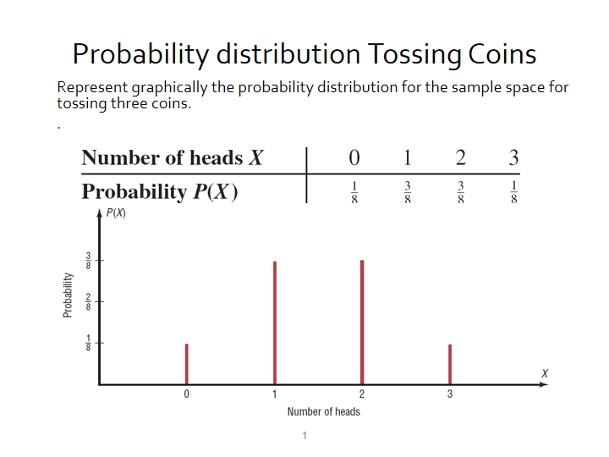

Slide 43
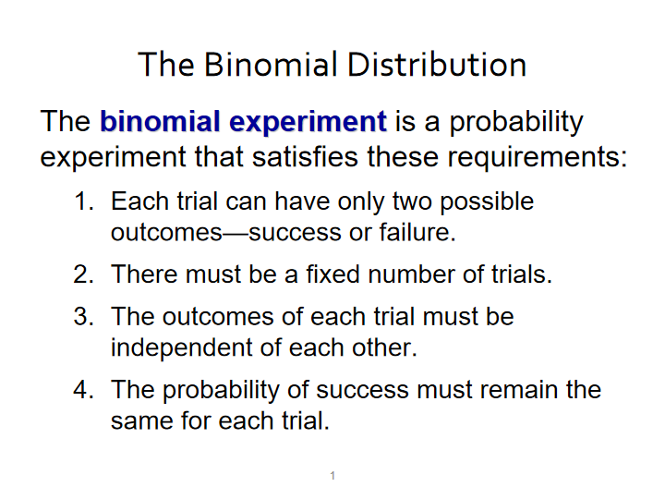

Slide 44
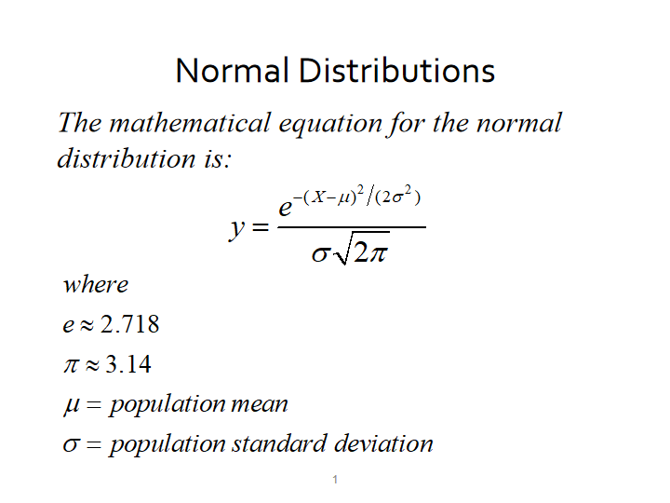

Slide 45
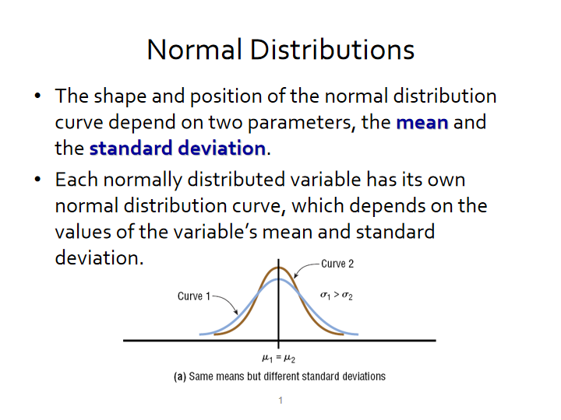

Slide 46
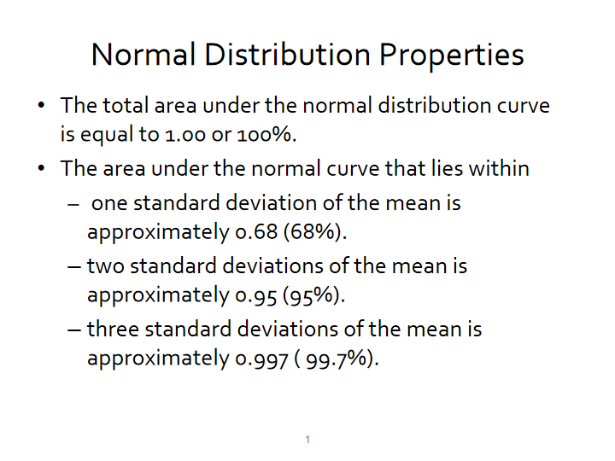

Slide 47
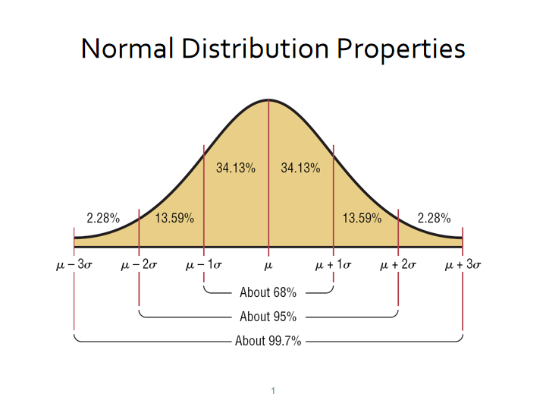

Slide 48
Pop Quiz: Which of the following are specific features of a normal distribution
The total area under the distribution is 1
Described by mean and sd
Symmetrical and bell shaped
Probabilities of specific events occurring can be calculated by area under the curve
Required for many statistical tests to be performed

Slide 49
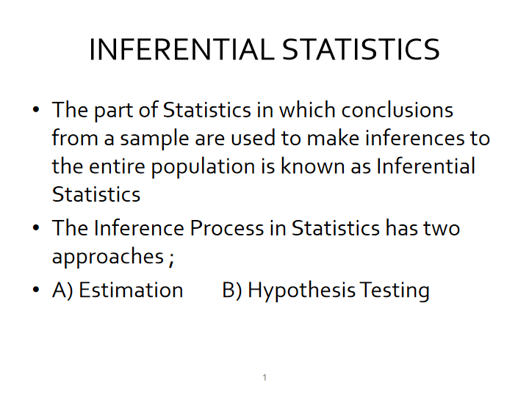

Slide 50
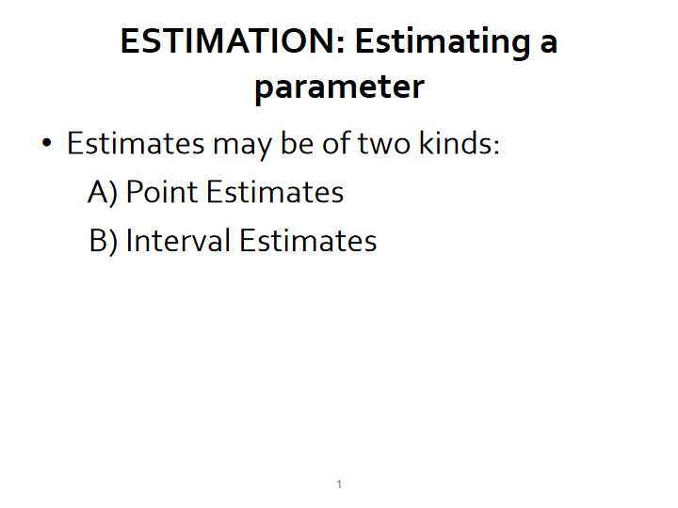

Slide 51
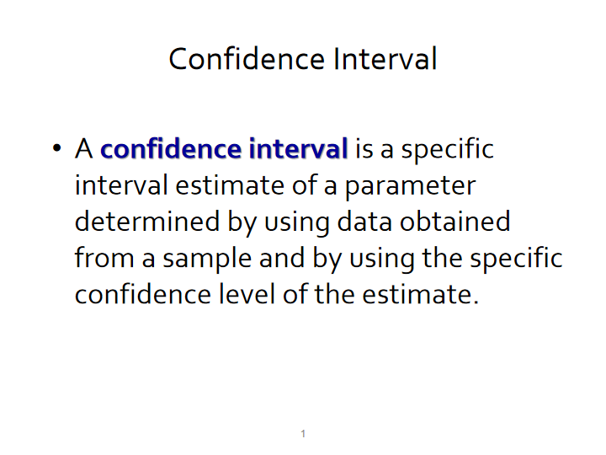

Slide 52
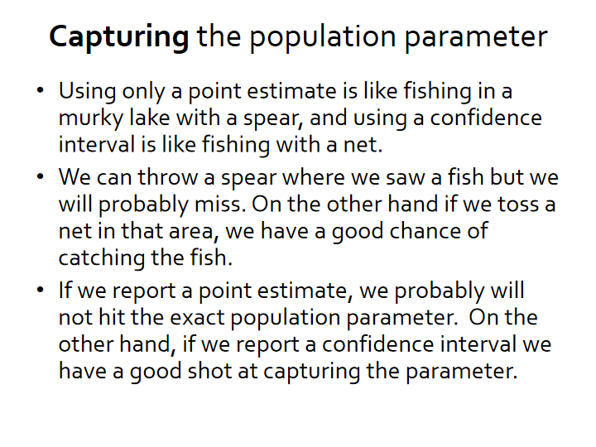

Slide 53
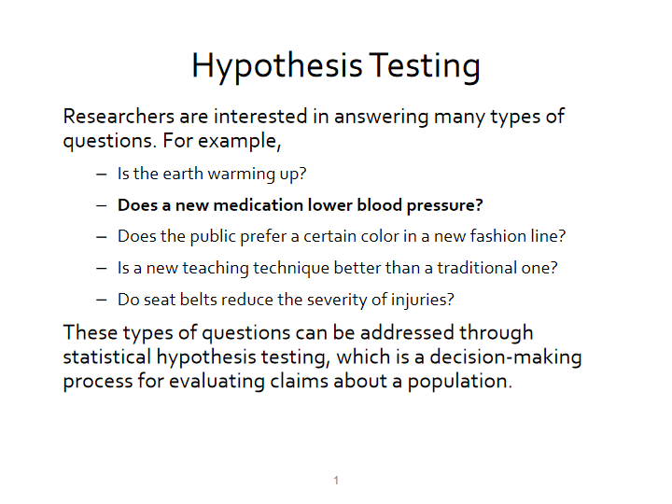

Slide 54
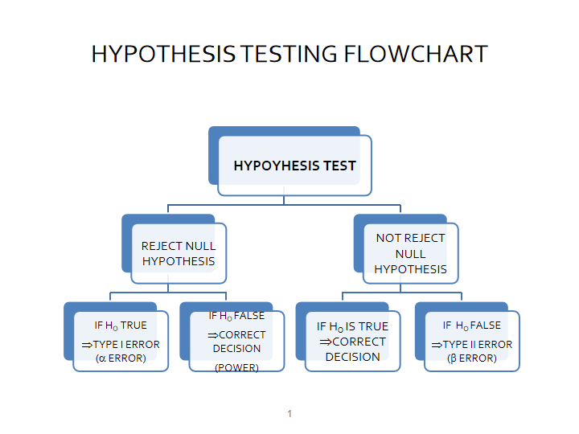

Slide 55
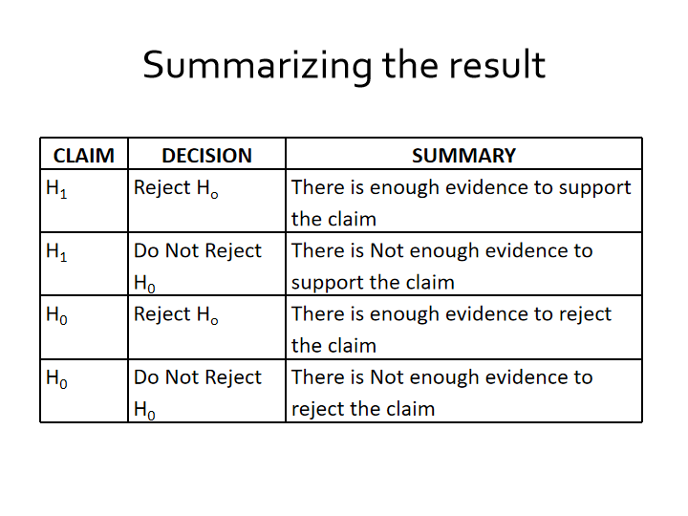

Slide 56
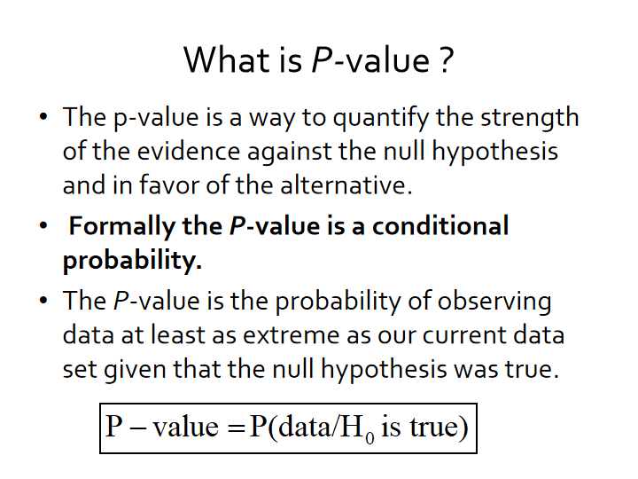

Slide 57
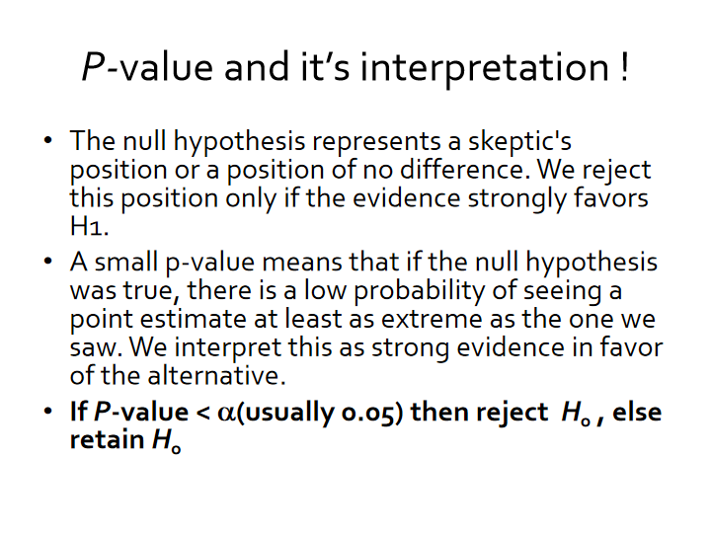

Slide 58
TESTS of SIGNIFICANCE
Single sample z- test
Single sample t-test
Independent Samples t-test
Dependent Samples t-test
Chi-square Test
ANOVA
Test of Correlation

Slide 59
Intro to ML

Slide 60
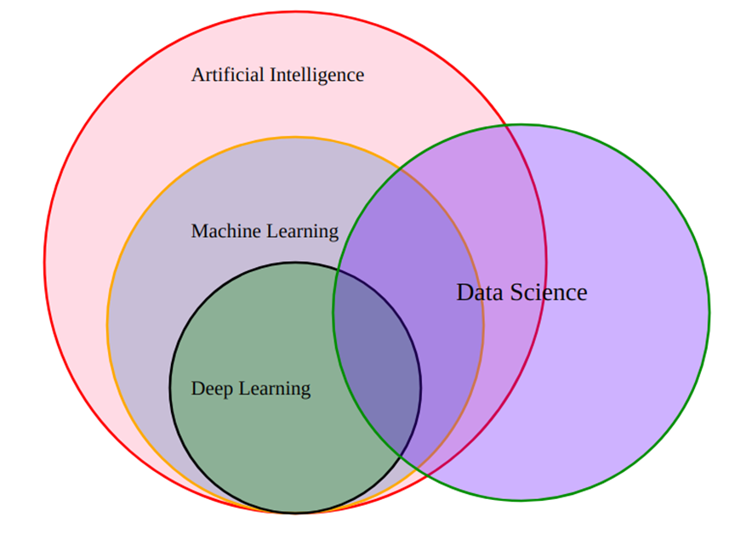
What are AI, ML and DS?
Notes:
AI- artificial Intelligence is a huge set of tools for making computers behave intelligently
ML- Machine Learning is the most prevalent subset of AI followed by Robotics
DS- Data Science deals with discovery and creating insights from data. ML is often an important data science tool.
DL- Deep Learning ,aka neural networks is a special area of ML and is best when inputs are images or text

Slide 61
What is ML ?
It is software/program that can learn from experience
ML gives computers the ability to learn from data without being explicitly programmed (`Arthur Samuel’ , 1959)

Slide 62
Traditional programming vs ML
The Output is the Rule

Slide 63
Fundamental difference between stats & ML
Machine learning tends to deal with large complex datasets such as dataset of millions of images each containing 1000s of pixels
Classical statistical analysis such as Bayesian analysis would be impractical for such datasets

Slide 64
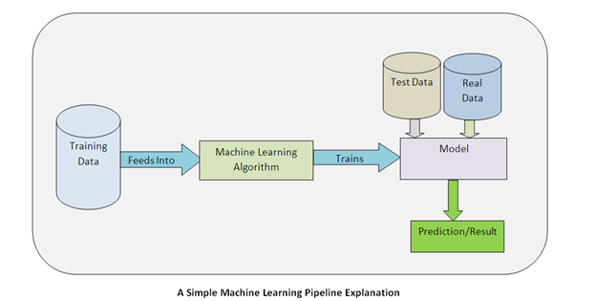

How does ML model look like in practice ?
Model -→ A statistical representation of a real world process based on data
X→ Training data also called features
y→ prediction also called labels
f(x)→ML algorithm for Training into a Model

Slide 65

Pop quiz
State True or False
A) To make predictions from ML model you need data
B) ML finds patterns in existing data & apply to new data
C) ML can only predict what will happen and not explain why something happens
D) ML’s applications is not limited to one type of problem/domain
TRUE
FALSE

Slide 66
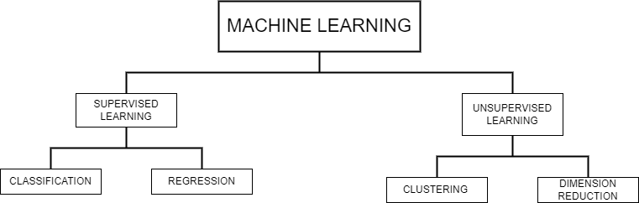
THE ML DIAGRAM
Notes:
Regression- when goal is to predict a numerical variable like House Price
Classification- when goal is to predict a class like Fraud/Not Fraud

Slide 67
Supervised Learning in python
We will use scikit learn/sklearn
→ integrates well with SciPy package
Other libraries
→ tensorflow
→ Keras

Slide 68
Data Scientist Toolkit
CLASSIFICATION
Logistic Regression.
k-Nearest Neighbors.
Decision Trees.
Random Forests
Support Vector Machine.
Naive Bayes.
Gradient Boosting Trees
AdaBoost
XGBoost
REGRESSION
Linear regression
Lasso Regression. ...
Decision Tree.
Support Vector Regression
Random Forest Regressor.
Clustering
K-means
Hierarchical clustering
DBScan

Slide 69
Model evaluation
To compute accuracy we should use data the model has not seen before. Split the dataset into training and testing data .Fit/train the classifier on the training set . Make the predictions on test set .Compare predictions with known labels

Slide 70

Model evaluation
For Classification
For Regression
Accuracy – In classification accuracy is a commonly used metric. Accuracy is the fraction of correct predictions
Precision- It is the model’s probability to convert. How accurate are the model’s predictions
Recall- model’s ability to recall the genuine positive values. It’s a measure of the models reach, ie higher the recall higher the reach
Coefficient of determination(R2)- a statistical measure of how well the data fits the regression line
Mean square error (MSE) – It is a measure of the mean of the squared error

Slide 71
Supervised Learning Steps
1. Data Acquisition
- Data sanity checks
- Data Cleaning- - Check for nulls, zero errrors, corrupt characters
2. Exploratory Data Analysis – univariate & bivariates & correlations
3. Data Preprocessing
-separate features and label
- Do the label encoding
- Solve data imbalance issue (if needed)
- Do a train test split
-scale the features (if needed, though it’s a good practice to scale the features)
4. Model Building with training data – Fit the model
5. Model evaluation with test data – Check the metrics
6. Model optimization-Hyperparameter tuning
7. Model interpretation
8. Deployment

Slide 72
Resources
Machine Learning Book ---https://www.ime.unicamp.br/~dias/Intoduction%20to%20Statistical%20Learning.pdf
Machine Learning Book Advanced- https://web.stanford.edu/~hastie/Papers/ESLII.pdf
For SMOTE---https://machinelearningmastery.com/smote-oversampling-for-imbalanced-classification/

Slide 73


